Slide 1




SUPERMARKET
DATA ANALYSIS
b y T a o f e e q . O . A b d u l l a t e e f

Slide 2
Welcome
TO THIS INSIGHTFUL PRESENTATION
https://github.com/taofeeq26/Supermarket-Data-Analysis

Slide 3

ABOUT ME
I am a young motivated and an inquisitive individual who loves to work on, and ask questions about data in order to uncover beneficial insights. I have been able to acquire analytical skills by practical methods laying hands on real- world datasets.
Taofeeq Olalekan Abdullateef
https://www.linkedin.com/in/taofeeqabdullateef 26/
Data Analyst

Slide 4

PROJECT OVERVIEW
This is an exploratory data analysis of a supermarket across its three major branches located in Yangon, Mandalay, and Naypyitaw in Myamar(Burma).
The dataset was gotten from Kaggle.
READ MORE

Slide 5



TOOLS USED
The analysis was carried out in Jupyter notebook with Python and its libraries.
Python
Pandas
Seaborn

Slide 6
5. Accurate conversion of the date and time column to datetime and extraction of specific date features.
STEPS AND TASKS COMPLETED.
Loading the datasets, combination of all the datasets in one CSV file for easy access.
Checking the number of rows and columns, using the shape attribute, to confirm the combination.
The statistical summary of the dataframe was generated using the describe function and beautiful insights were uncovered.
Missing values were checked for, in order to aid effective data cleaning.
The total count figures of each categorical column were generated.
A table showing the gross income of each branch was generated through grouping by the city column and the city with the highest gross income was determined.
The branch with the most sales was determined using the countplot method.
The highest and lowest sales of each product line was determined.
The payment mode adopted by most customers for each product line was uncovered.
The relationship between the gender column and the product line was discovered and shown using the countplot method.
The relationship between the customer type and the product line column was also shown.

Slide 7
INSIGHTS SUMMARY

Slide 8
INSIGHT SUMMARY
The average Tax(5%) paid across all the three branches is 15.38
The average gross income across all the three branches is 15.38
There was no record of missing data.
Branch C which is located in Naypyitaw has the highest amount of total tax paid (5265.1765).
Branch C has the highest total gross income (5265.1765).
Branch A ( Yangon) has more sales than the other two branches.
The mostly used payment channel is Ewallet.
The products (Food and Beverages, Fashion Accessories, and Sports and Travel) was patronized by more females than males.
The product Health and Beauty has more male customers than females.
There were more 'Normal' customers than 'Member' customers.

Slide 9
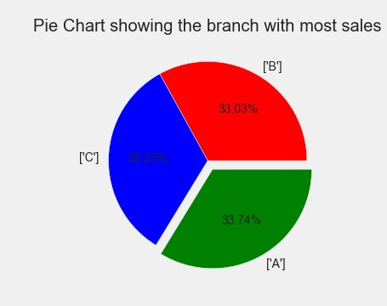
Branch A ( Yangon) has more sales than the other two branches.

Slide 10
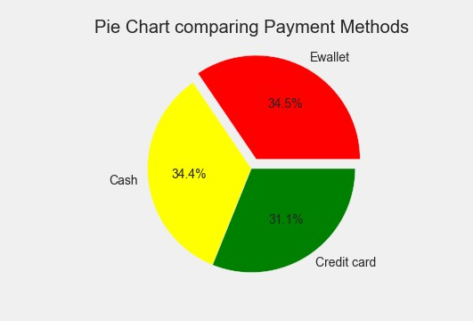
The most used payment channel is Ewallet.

Slide 11
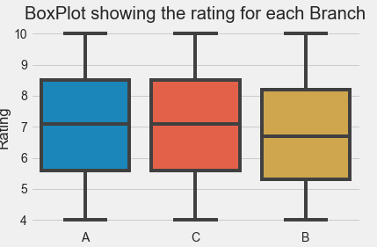
Branch B has the highest rating

Slide 12
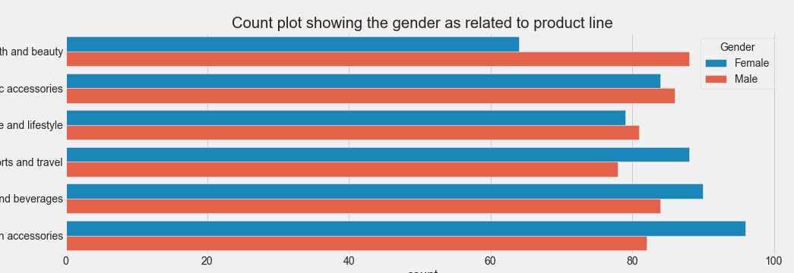
The product Health and Beauty has more male customers than females

Slide 13
THANK YOU!
+234-915-911-3493

